Slide 1
ACECH Presentation
Joseph Uno, LEED AP BD+C
J. Uno & Associates, Inc.

Slide 2
Engineering News Record
Construction Cost Index
ENR CONSTRUCTION COST INDEX |  |  | ENR 20 CITY FEB. 22, 2016 |  | HAWAII
ITEM | QTY | UNIT | COST | ENR | COST | HAWAII | FACTOR
Common Labor | 200 | hours | $41.42 | $8,284.00 | $52.36 | $10,472.00
Fabricated Structural Steel | 25 | cwt | $49.94 | $1,248.50 | $85.00 | $2,125.00
Portland Cement | 1.128 | tons | $114.50 | $129.16 | $209.14 | $235.91
2x4 | 1.088 | mbf | $478.09 | $520.16 | $851.00 | $925.89
 |  |  |  | $10,181.82 |  | $13,758.80 | 1.35

Slide 3
Engineering News Record
Building Construction Cost Index
ENR BUILDING COST INDEX |  |  | ENR 20 CITY FEB. 22, 2016 |  | HAWAII
ITEM | QTY | UNIT | COST | ENR | COST | HAWAII | FACTOR
Skilled Workers * | 68.38 | hours | $53.84 | $3,681.58 | $64.03 | $4,378.37
Fabricated Structural Steel | 25 | cwt | $49.94 | $1,248.50 | $85.00 | $2,125.00
Portland Cement | 1.128 | tons | $114.50 | $129.16 | $209.14 | $235.91
2x4 | 1.088 | mbf | $478.09 | $520.16 | $851.00 | $925.89
 |  |  |  | $5,579.40 |  | $7,665.17 | 1.37
* Skilled Workers
Bricklayers | $60.57
Carpenters | $64.86
Structural Ironworkers | $66.66
Average | $64.03

Slide 4
Engineering News Record
Labor Costs
I researched the prevailing wage rates of the 22 construction trades which are included in ENR’s 20 City average wage rates, 3rd Quarter 2014 and compared them to Hawaii’s rates for the same period. The data shows that the overall average factor of Hawaii labor costs over the ENR 20-city average rates 1.210.
It is important to note that this factor is the result of a purely objective comparison of local wage rates to a national average and do NOT reflect productivity or other economic measures.

Slide 5
Engineering News Record
Material Costs
ENR regularly reports on the cost of 57 different building materials from 20 major U.S. cities. I compared Hawaii costs with ENR’s 20 City Average cost of the same materials which include; Lumber, Plywood, Drywall, Insulation, Metals, Masonry, Concrete, Paving, Aggregates and Pipes. I found that material price factor in Hawaii is 2.038.

Slide 6
RSMeans
Labor Costs
The Labor rates used by RSMeans are an average of 18 trades’ wage rates in 30 different cities across the United States. Labor rates include fringe benefits and carry markups for both profit and overhead. I compared the RSMeans National Average rates with Hawaii’s rates and found a factor of 1.254. The RSMeans City Cost Index for Labor is 1.197.
This factor is an objective sampling of labor rates and includes no accounting for productivity or other economic impacts.

Slide 7
RSMeans
Material Costs
I researched and compared the local costs of the 65 items which make up the R.S. Means Key Materials List. The overall average factor is 2.026. This factor, based on actual, researched material costs in Hawaii, contrasts with the RSMeans City Cost Index for Materials in Honolulu of 1.250.

Slide 8
Case Studies
Student Housing
In the “Sweet’s Architect’s Square Foot Cost Book”, a student apartment complex in Maryland was constructed which consisted of 107 units totaling 153,338 s.f.. The resulting square foot cost for this complex was $93.51/s.f..
Using the ENR ACF of 1.387, the adjusted square foot cost in Hawaii would be:
$93.51 x 1.38 = $129.04/s.f..
A new dormitory was constructed at the University of Hawaii Hilo for $232.31/s.f.
$232.31/$93.51 = 2.48

Slide 9
Case Studies
Parking Garage
In the “ENR 2015 Square Foot Cost Book”, a 743 stall, 287,068 s.f. parking garage was constructed for $11,904,749 or $41.47/s.f..
Using the ENR Metro Area Multiplier for Hawaii of 1.38, the adjusted square foot cost in Hawaii would be $57.23/s.f..
A new 429 stall, 217,905 s.f. parking garage is under construction on Oahu for $29,330,000 or $134.60/s.f..
$134.60/$41.47 = 3.25.

Slide 10
ENR & Rsmeans summary
ENR and RSMeans Labor factors are objectively derived and do not account for deviations in productivity or other economic conditions.
When you look at the average cost of materials vs. national averages, Hawaii’s material costs are 2x more.
The cost of living is higher in Hawaii which drives up our overhead costs and compounds over and over from supplier, to subs, to primes.

Slide 11
Current Conditions
The current market in Hawaii is saturated to the point that many Generals and Subcontractors are at capacity. Their "A" crews are committed to the high end condos and commercial projects.
Recent observation by a project superintendent was that the “Boom and Bust” cycles of the local construction market along with our relatively small market do not provide consistent opportunities for tradesmen to gain skills and experience compared to their counterparts on the mainland. This has significant impact on output and productivity.
Another project superintendent shared that he sees only half the productivity from our labor force than he had seen in other markets. Half Productivity = 2 X the cost of labor.

Slide 12
Current Conditions
NAVFAC-Hawaii projects are all constrained to Small Business Enterprises and bidding is limited to 8A Set Asides via 8A MACC's. This limits the competition and in many cases we are seeing large "Prime-Subcontractors" being signed up by the 8A Contractors.
Having said that, in regards to the 8A MACC's, NAVFAC-Pacific has also witnessed bid busts in full and open situations as well.
What I see happening at times is that we will prepare an early estimate based on higher numbers but then we, as the design team, are forced to sharpen pencils and cut scope and cost. However, scope reductions are limited by statute (1391) and the team feels compelled to try to meet expectations.

Slide 13
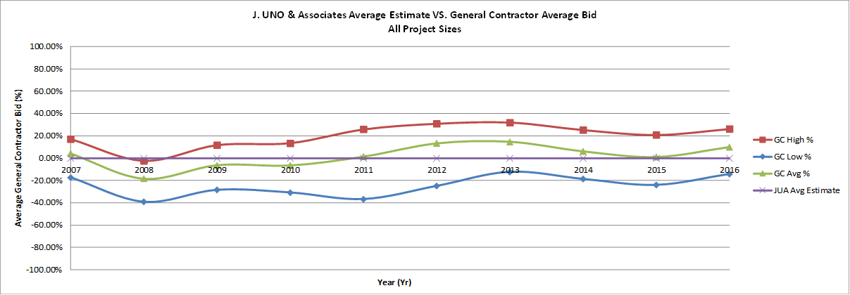
Cost Trends

Slide 14
Conclusion
It is all well and good to ask us estimators to come within a range, that is what we try to do without being asked. We strive to prepare estimates that a reasonable, responsible contractor would bid. However, the current bidding environment is anything but reasonable with no end in sight. There's no way for us to know that there will be only one mechanical subcontractor bidding a job and wanting to take a job for 2x the normal cost.

